Slide 1
CS4104 Machine Learning
Course Outline

Slide 2
Course Learning Outcomes (CLOs)
Understand the basic concepts and algorithms in machine learning (ML). Supervised learning, unsupervised learning, reinforcement learning.
Understand and Apply statistical models to solve problems in ML, with a focus on how the vector-space, Bayesian and decision tree models are implemented and applied to classification, regression and clustering.
ML models for combination in terms of ensembles, Boosting and stacking and ML algorithms’ components including hypothesis, loss functions and optimization.
Evaluations of the ML algorithms with variance and bias trade-off.

Slide 3
Topics
Introduction, Supervised Learning, Unsupervised Learning, Semi-Supervised Learning, Reinforcement learning
Data types for ML, Classification and Regression Algorithms
KNN
Baysian
SVM
Decision Tree
Linear Regression
Logistic Regression
Evaluations
Clustering
K-Means Clustering
Hierarchical Clustering
Feature Selections
Principal Component Analysis (PCA)
Ensemble and Combination of ML Algorithms
Neural Network (Back Propagation)

Slide 4
Books
Machine Learning: An Algorithmic Perspective, Stephen Marsland, Second Edition
Introduction to Data Mining by Pang-Ning Tan, Michael Steinbach, Anuj Karpatne, Vipin Kumar. Second Edition

Slide 5
Assessments
Quizzes/Assignments (10 Marks)
5 Programming Assignments
5 Quizzes (short questions Non-Programming)
Class Project (10 Marks)
Assessment will be in three phases
Proposal
Results prediction
Reporting and Visualizations
Midterms (30 Marks)
Two midterms 15 marks each
Final Exam (50 Marks)
One Exam of 50 marks from all course contents

Slide 6
Course Instructor
Zeshan Khan
Office
Office # 32, Ground Floor, Academic Block
Contacts
zeshan.khan@nu.edu.pk
http://zeshankhanalvi.com

Slide 7
CS4104 Machine Learning
An Introduction

Slide 8
Machine Learning
Field of study that gives computers ability to learn
Machine learning is programming computers to optimize a performance criterion using example data or past experience.
There is no need to “learn” to calculate payroll
Learning is used when:
Human expertise does not exist (navigating on Mars),
Humans are unable to explain their expertise (speech recognition)
Solution changes in time (routing on a computer network)
Solution needs to be adapted to particular cases (user biometrics)

Slide 9
Learning
Tom Mitchell (1998): A computer program is said to learn from experience E with respect to some task T and some performance measure P, if its performance on T, as measured by P, improves with E

Slide 10
Examples
Task: Face Recognition
Experience: Images or Examples
Performance Measure: Accuracy

Slide 11
Applications
Predict whether a patient, hospitalized due to heart attack, will have a second heart attack
Predict the price of a stock in 6 months from now
Pace detection: find faces in images (or indicate if a face is present)
Spam filtering: identify email messages as spam or non-spam
Fraud-detection applications that seek patterns in jumbo size data sets

Slide 12
Commercial Viewpoint
Lots of data is being collected and warehoused
Web data, e-commerce
purchases at department/grocery stores
Bank/Credit Card transactions

Slide 13
Machine Learning
Supervised
Classification
Regression
Un-Supervised
Semi Supervised
Reinforcement
Association

Slide 14
Supervised Learning
Learn from Supervised Training Data
For example; spam filtering where Large number of email messages labelled as either
Spam
non-spam
New email message will then be classified as spam or non-spam

Slide 15
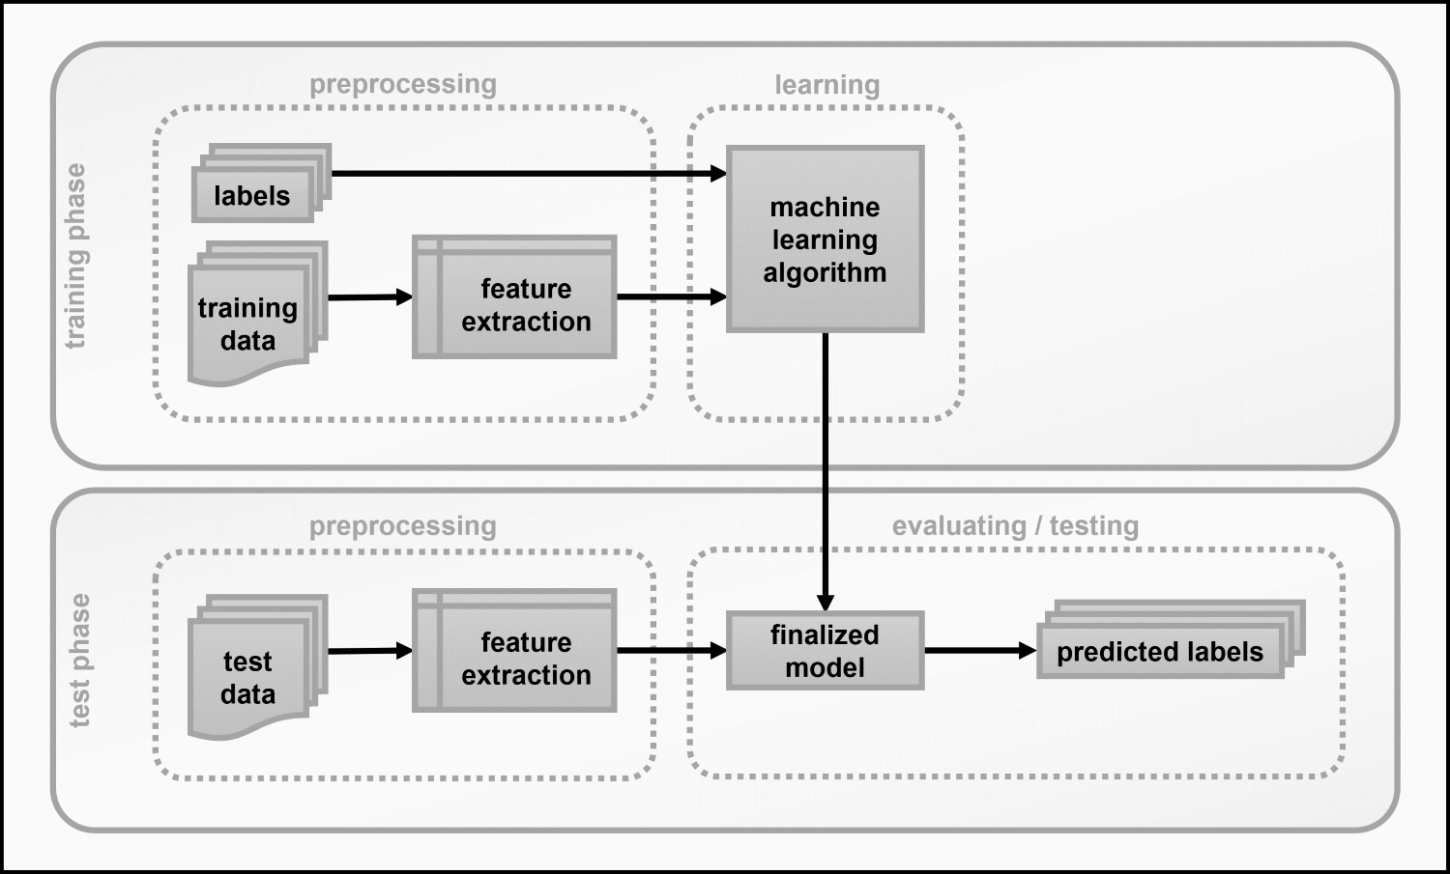

Slide 16
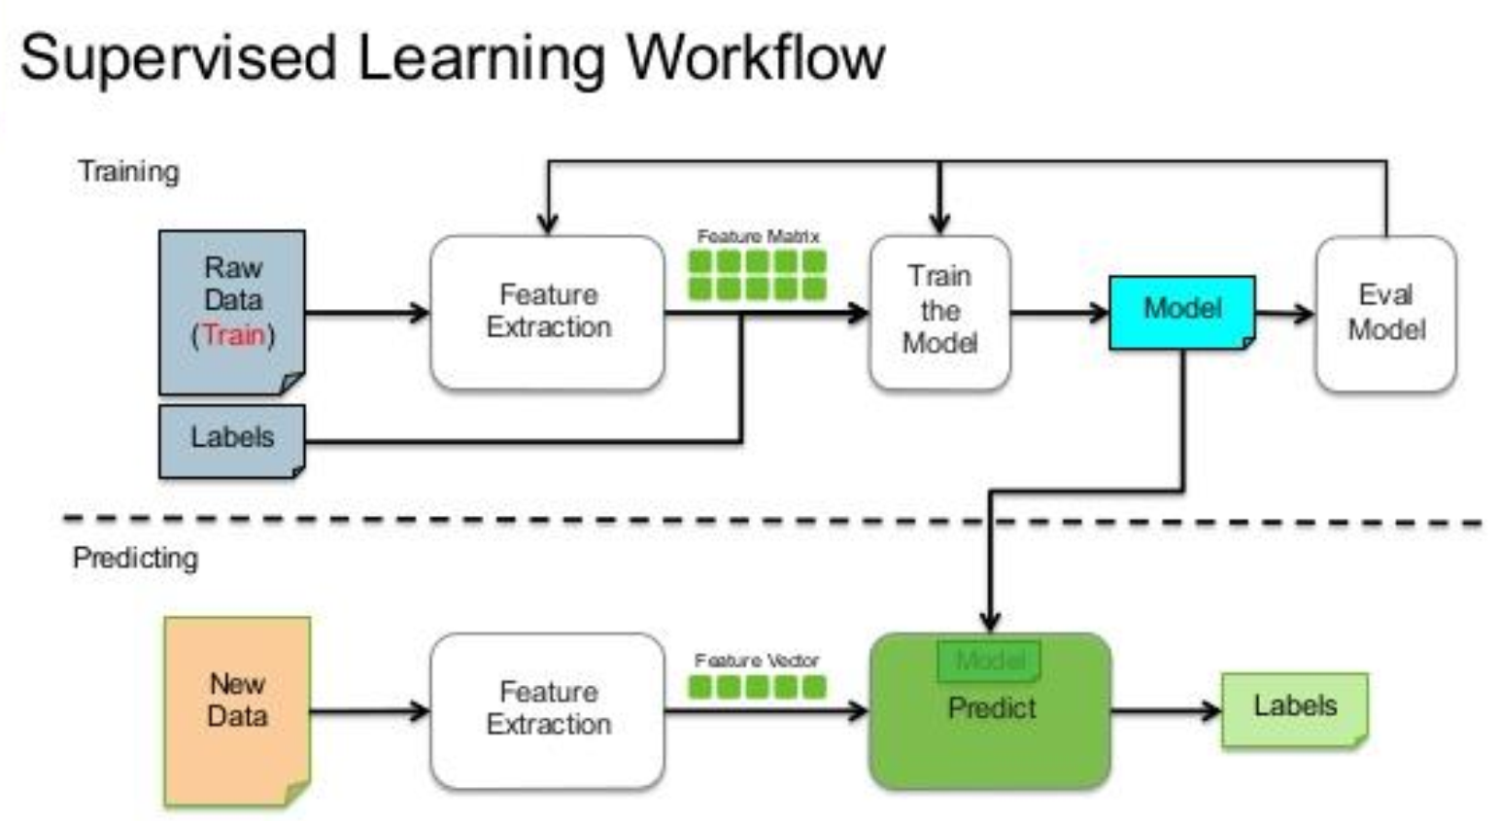

Slide 17
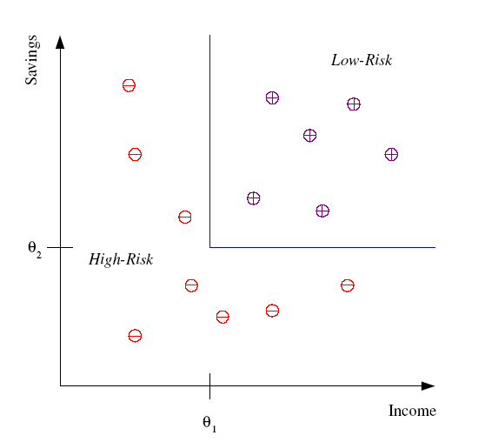
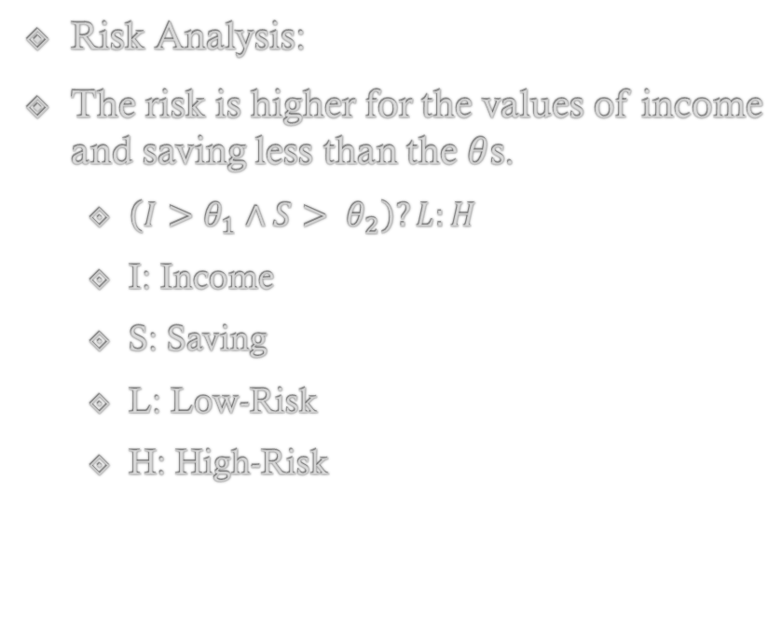
Classification
Risk Analysis:
The risk is higher for the values of income and saving less than the $θ$s.
$\left(I>θ_{1}∧S> θ_{2}\right)?L:H$
I: Income
S: Saving
L: Low-Risk
H: High-Risk

Slide 18
Applications
Pattern recognition
Face recognition: Pose, lighting, occlusion (glasses, beard), make-up, hair style
Character recognition: Different handwriting styles.
Speech recognition: Temporal dependency.
Medical diagnosis: From symptoms to illnesses
Biometrics: Recognition/authentication using physical and/or behavioral characteristics: Face, iris, signature, etc
Outlier/novelty detection

Slide 19
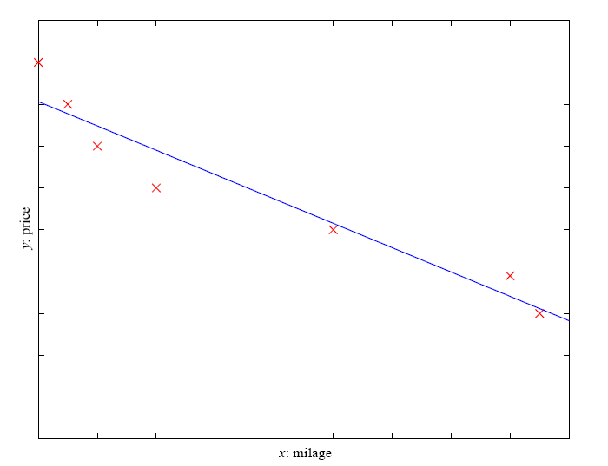
Regression
Example: Price of a used car
x : car attributes
y : price
y = g (x | θ )
g ( ) model,
θ parameters
y = wx+w₀

Slide 20
Regression Applications
Navigating a car: Angle of the steering
Kinematics of a robot arm
(x,y)
α₁= g₁(x,y)
α₂= g₂(x,y)
α₂
α₁
Response surface design

Slide 21
Supervised Learning: Uses
Prediction of future cases: Use the rule to predict the output for future inputs
Knowledge extraction: The rule is easy to understand
Compression: The rule is simpler than the data it explains
Outlier detection: Exceptions that are not covered by the rule, e.g., fraud

Slide 22
Data Types
Categorical
A variable that can take on one of a limited number of possible values. E.g. Grades A to F, Olympic games (GameA, GameB etc.)
Numerical
A variable that can take a real value. E.g. 1, 2, 3, 4.
Some more data types…

Slide 23


Classification Vs Regression
Classification
Regression
$Y=f\left(x\right):x∈X and Y∈\{c_{1},c_{2},c_{3},…,c_{n}\}$
Where X is a vector representation of features.
Y is a class label from a finite set of labels.
$Y=f\left(x\right):x∈X and Y∈R$
Where X is a vector representation of features.
Y is a regression value which can be any real value.

Slide 24
Unsupervised Learning
The correct classes of training data are not known
Applications
Fraud Detection: Identify groups of motor insurance policy holders with a high average claim cost
Social Networks: Recognize communities within large groups of people

Slide 25
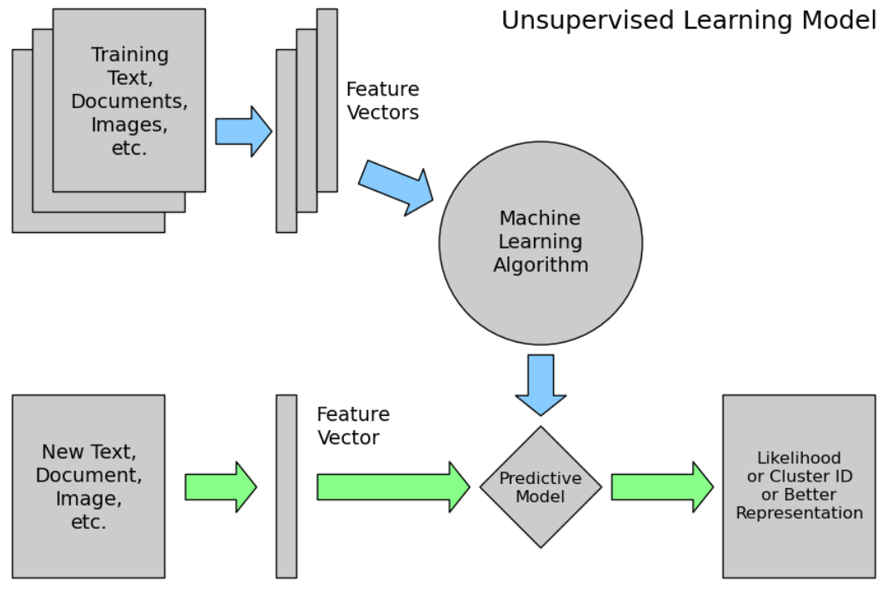

Slide 26
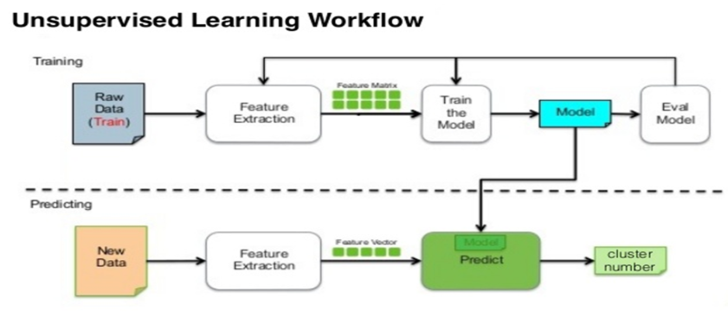

Slide 27
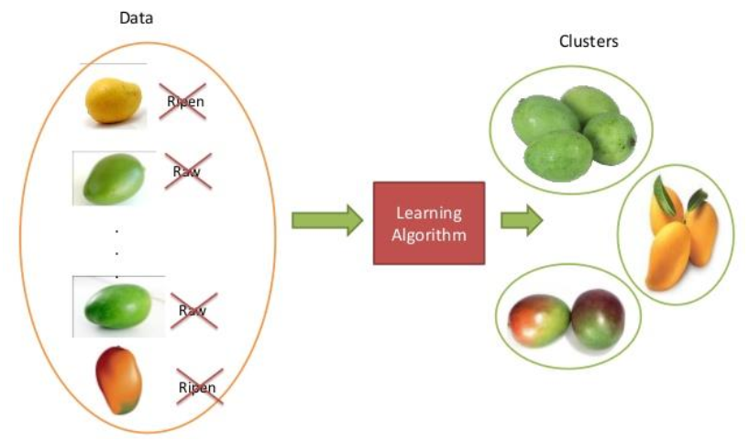
Example

Slide 28
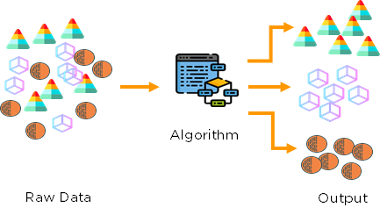
Example…

Slide 29
Unsupervised Learning
Learning “what normally happens”
No output
Clustering: Grouping similar instances
Example applications
Customer segmentation in CRM
Image compression: Color quantization
Bioinformatics: Learning motifs

Slide 30
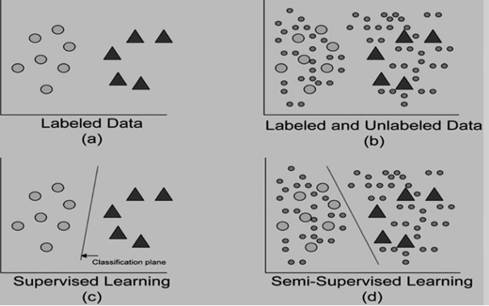
Semi-Supervised Learning
Learning from a small amount of labeled data and a large amount of un-labeled data.
Notes:
Photo Source: https://medium.com/dataseries/facebook-likes-omni-supervised-learning-to-train-models-with-limited-labeled-datasets-892961c3c9b8

Slide 31
Reinforcement Learning
Learning a policy: A sequence of outputs
No supervised output but delayed reward
Credit assignment problem
Game playing
Robot in a maze
Multiple agents, partial observability, ...

Slide 32
Association
Basket analysis:
P (Y | X ) probability that somebody who buys X also buys Y where X and Y are products/services.
Example: P ( chips | cold drink ) = 0.7

Slide 33
CS4104 Machine Learning
K Nearest Neighbors Classifier

Slide 34
Instance Based Learning
First Example of Supervised Classification
Rote-learner
Memorizes entire training data and performs classification only if attributes of record match one of the training examples exactly
Nearest neighbor
Uses k “closest” points (nearest neighbors) for performing classification

Slide 35
Instance Based Learning
Labeled Data
Unlabeled Data
Att1 | Att2 | Class
1 | 2 | A
5 | 7 | B
2 | 5 | A
4 | 2 | B
Att1 | Att2 | Class
1 | 2 | ?
2 | 6 | ?
3 | 4 | ?

Slide 36
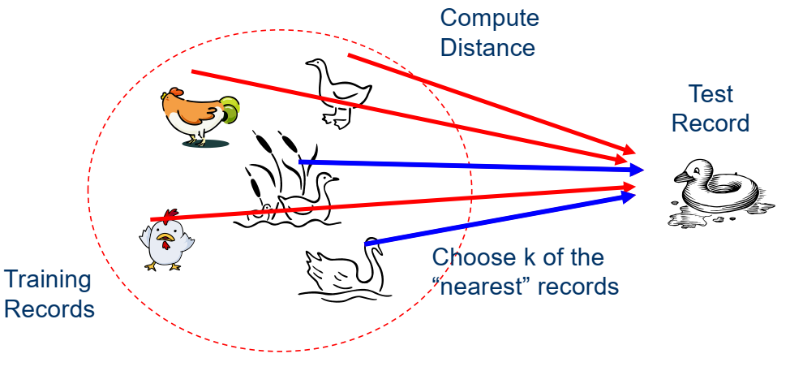
Nearest Neighbors

Slide 37
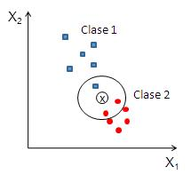
K Nearest Neighbors
Requires three things
The set of stored records
Distance Metric to compute distance between records
The value of k, the number of nearest neighbors to retrieve
To classify an unknown record:
Compute distance to other training records
Identify k nearest neighbors
Use class labels of nearest neighbors to determine the class label of unknown record (e.g., by taking majority vote)

Slide 38
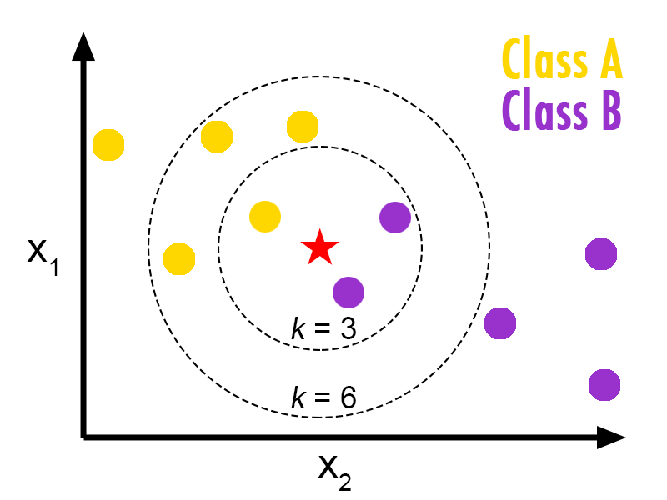
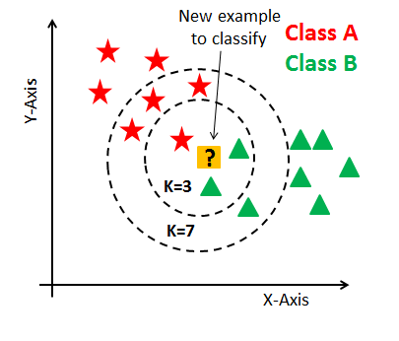
K Nearest Neighbors (KNN)

Slide 39
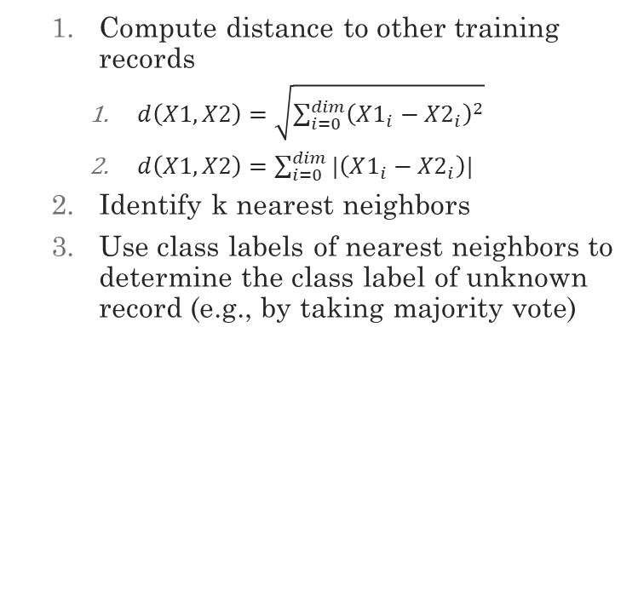
K Nearest Neighbors
Compute distance to other training records
$d\left(X1,X2\right)=\sqrt{\sum_{i=0}^{dim}{{\left(X1_{i}−X2_{i}\right)}^{2}}}$
$d\left(X1,X2\right)=\sum_{i=0}^{dim}{{|\left(X1_{i}−X2_{i}\right)|}^{}}$
Identify k nearest neighbors
Use class labels of nearest neighbors to determine the class label of unknown record (e.g., by taking majority vote)

Slide 40
Example
X1 | X2 | Class
1 | 3 | B
2 | 4 | B
3 | 2 | A
5 | 4 | A
2 | 5 | ?
Assuming Distance as city block distance

Slide 41
Example
X1 | X2 | Class | Distance
1 | 3 | B
2 | 4 | B
3 | 2 | A
5 | 4 | A
2 | 5 | ?
Compute distance to other training records
Identify k nearest neighbors
Use class labels of nearest neighbors to determine the class label of unknown record (e.g., by taking majority vote)
|2-1|+|5-3|=3
|2-2|+|5-4|=1
|2-3|+|5-2|=4
|2-5|+|5-4|=4

Slide 42
Example (k=1)
X1 | X2 | Class | Distance
1 | 3 | B
2 | 4 | B
3 | 2 | A
5 | 4 | A
2 | 5 | ?
Compute distance to other training records
Identify k nearest neighbors
Use class labels of nearest neighbors to determine the class label of unknown record (e.g., by taking majority vote)
|2-1|+|5-3|=3
|2-2|+|5-4|=1
|2-3|+|5-2|=4
|2-5|+|5-4|=4

Slide 43
Example (k=2)
X1 | X2 | Class | Distance
1 | 3 | B
2 | 4 | B
3 | 2 | A
5 | 4 | A
2 | 5 | ?
Compute distance to other training records
Identify k nearest neighbors
Use class labels of nearest neighbors to determine the class label of unknown record (e.g., by taking majority vote)
|2-1|+|5-3|=3
|2-2|+|5-4|=1
|2-3|+|5-2|=4
|2-5|+|5-4|=4

Slide 44
Example (k=1,2)
X1 | X2 | Class | Distance
1 | 3 | B
2 | 4 | B
3 | 2 | A
5 | 4 | A
2 | 5 | B
Compute distance to other training records
Identify k nearest neighbors
Use class labels of nearest neighbors to determine the class label of unknown record (e.g., by taking majority vote)
|2-1|+|5-3|=3
|2-2|+|5-4|=1
|2-3|+|5-2|=4
|2-5|+|5-4|=4

Slide 45
Issues in KNN
Scaling Issues (Data Normalization)
Attributes may have to be scaled to prevent distance measures from being dominated by one of the attributes. E.g. The Salary and GPA have different ranges.

Slide 46
KNN Pseudo Code
Constructor
Train
Test

